Slide 1
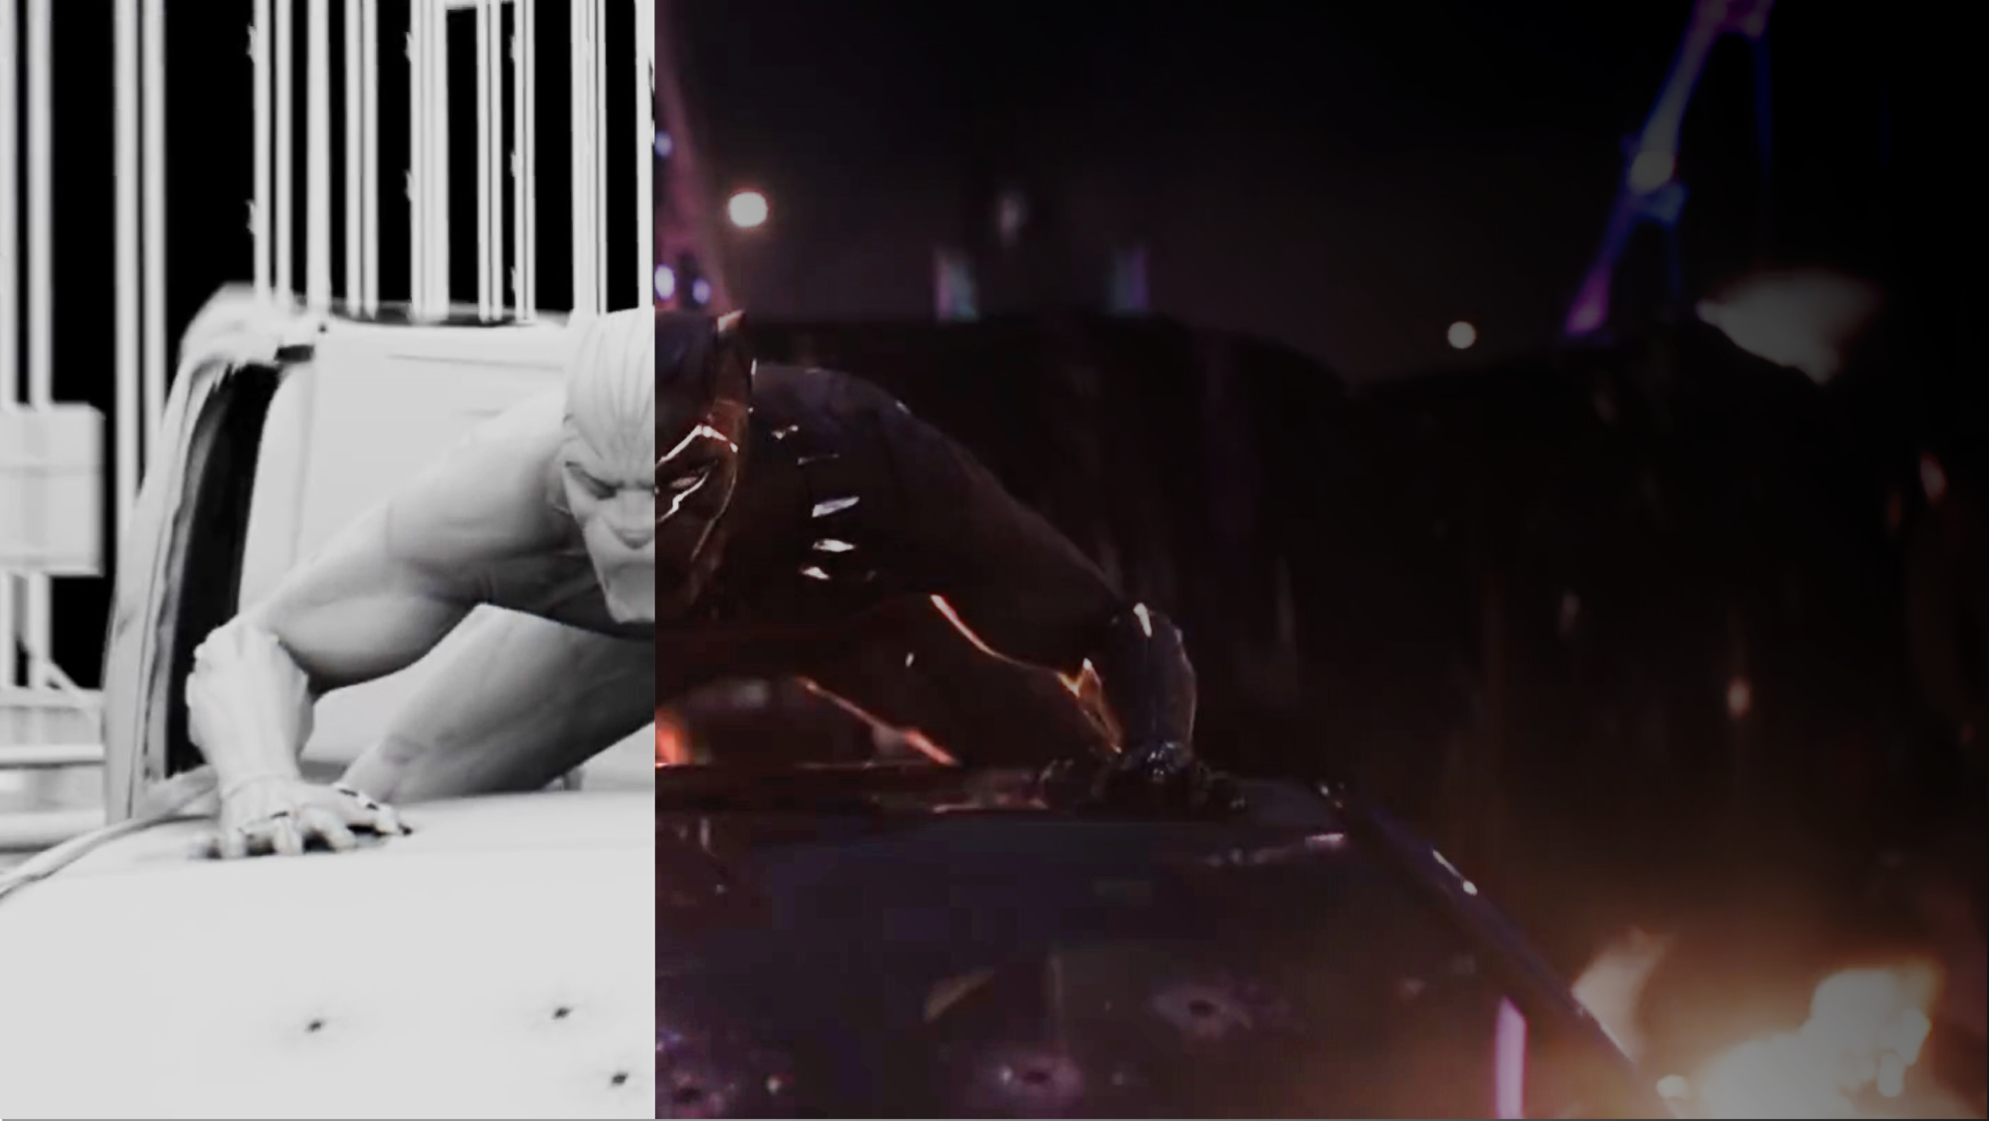

ARCHIVING VFX
a research project to
preserve evidence of film
digital VFX production
Evanthia Samaras
PhD Candidate
University of Technology, Sydney
@CyberKittyFace
FILM: BLACK PANTHER (2018) | STUDIO: MARVEL STUDIOS, WALT DISNEY PICTURES | VFX: LUMA PICTURES | IMAGE SOURCE: www.artofvfx.com/
NTTW3 LIGHTNING TALK | 25 OCTOBER 2018
Notes:
Hi Everyone! My name is Evanthia Samaras. I am a PhD Candidate at the University of Technology Sydney (or UTS for short). Today I am going to discuss my doctoral research project, which is about archiving and preserving film digital visual effects records.

Slide 2

AGENDA
ABOUT FILM VFX
Brief introduction to film VFX and the current state of archiving in the industry.
ABOUT MY RESEARCH
Introduction to UTS ALA and outline of research thesis, aims, objectives and approach.
Q&A
Question time.
NTTW3 LIGHTNING TALK
EVANTHIA SAMARAS | 25 OCTOBER 2018
Notes:
So today, I will present my lightning talk in the following parts:
Part one will briefly introduce film visual effects and the current state of archiving
Part two will outline my PhD research project
Then hopefully we will have enough time for questions at the end.

Slide 3
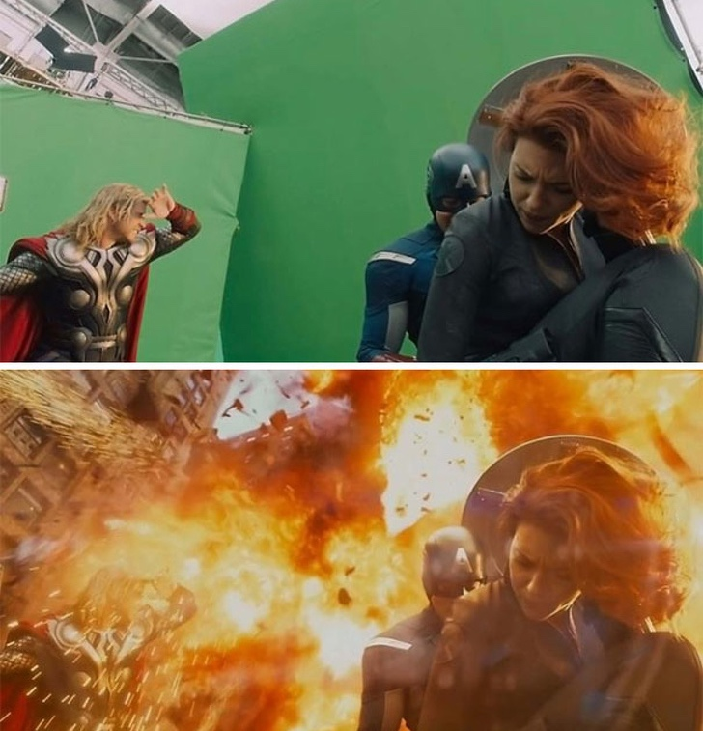
PART 1
FILM
VISUAL EFFECTS
NTTW3 LIGHTNING TALK
EVANTHIA SAMARAS | 25 OCTOBER 2018
FILM: THE AVENGERS (2012) | STUDIO: MARVEL STUDIOS, WALT DISNEY PICTURES | VFX: ILM | IMAGE SOURCE: http://cinefex.com/blog/greenscreen/
Notes:
Ok so let’s begin! Part 1… Film VFX

Slide 4
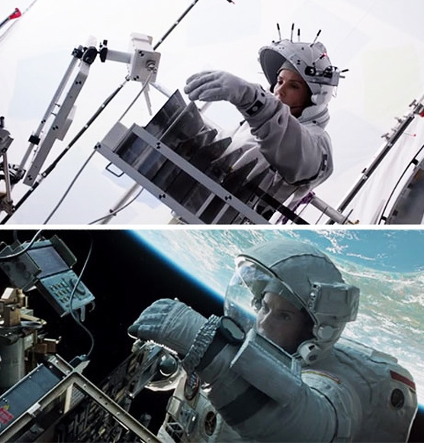
ABOUT THE
VFX INDUSTRY
Visual effects (VFX) are one of the many creative toolsets available to filmmakers to visually represent concepts, themes, environments, characters and performances to audiences via the big (or small) screen.
VFX work spans from pre to post production. It includes such tasks as pre-visualisation, tracking, modelling, rigging, texturing and surfacing, lighting, matte painting, effects and digital compositing [1].
The industry is made up of over 500 companies situated all over the world. VFX companies bid on film VFX work to work on “shots” in film projects. Much of the industry relies on work from Hollywood film studio projects.
[1] Jean Chung, H. 2011, 'Global visual effects pipelines: an interview with Hannes Ricklefs', Media Fields Journal, no. 2, pp. 1–9.
FILM: GRAVITY (2013) | STUDIO: WARNER BROS. | VFX: FRAMESTORE | IMAGE SOURCE:
https://brightside.me/
Notes:
About Visual Effects
So, visual effects (or VFX) is the process of creating and manipulating imagery which is computer generated and combining it with live action shots. Many of the processes used in VFX are comparable to computer animation, so artists often work across both fields.
VFX is an element of filmmaking that has become commonplace in the last few decades. And when it is done well, often audiences cannot even tell that what they are watching is real or computer generated.
VFX work spans from pre to post production. So many people people often assume VFX all happens after filming, but it can also happen at the beginning of a film project to help design the visual look of the film and plan particular shots.
VFX includes a range of tasks which are carried out by different teams or departments. These include: tracking, modelling, rigging, animation, texturing, surfacing, lighting, matte painting, effects and digital compositing.
The industry is made up of over 500 companies situated all over the world. On a feature film project, VFX companies will bid for work which is generally referred to as “shots” in a film. Much of the industry relies on work from Hollywood studios and blockbuster projects like Disney/Marvel films are considered bread and butter for the VFX industry. So multiple VFX companies my be hired to work on a single film project. They may work on a handful of shots or 100s of shots.

Slide 5
VFX ARCHIVING
CURRENT STATE
CHALLENGE #1 Complex
VFX records are diverse in size and format and are created and stored in vast volumes on varied mediums
VFX practitioners presently view archiving as a process of back up and ongoing maintenance; as opposed to a series of managed activities designed to facilitate the long-term digital preservation of their records.
Film studios, the content “owners” of many VFX records, do not stipulate consistent requirements for VFX records delivery and archiving.
As a result:
there are no established archival and preservation practices within the VFX industry
the records are currently at high risk of becoming unmanageable and lost over time.
CHALLENGE #2 Multiple agents
VFX records are manifested and controlled by multiple creators and owners situated in varied global locations.
CHALLENGE #3 Obsolescence
VFX records are destined for obsolescence. They are produced within evolving production pipeline environments using tools, software and hardware that constantly change from project to project.
NTTW3 LIGHTNING TALK | 25 OCTOBER 2018 | EVANTHIA SAMARAS
Notes:
Current State of Archiving
So surprise, surprise… Currently the industry doesn’t properly archive their records. “Archiving” to them is a process of backing up their project work and shots. It’s not always a planned process to preserve items long-term, and they don’t consistently appraise and select records and digital assets for archiving. Also, the industry does not generally hire any records management or archiving specialists to help manage this process – it is often managed by IT with input from other departments.
One of the big preservation issues is that VFX companies do not generally own the rights to their work – the studios own the copyright and VFX artists are just work-for-hire. So technically, it is not always clear what VFX companies are allowed to keep. Also, presently the industry has no established practices or standards for archiving – meaning that the studios, the “owners” of this material make their own adhoc requests regarding which records they want and the formats and quantities.
This lack of common practice and knowledge of archiving puts VFX records at risk of becoming unmanageable, obsolete and lost over time.
So over here in the box are some of the key challenges with archiving and preserving VFX records:
They are complex: digital records are diverse in size and format and are created and stored on varied mediums, often in multiple locations.
They have multiple agents – So as I mentioned earlier, for a single film project you may have a studio and multiple VFX companies working on various shots. So this makes aggregating and maintaining consistency much harder.
They are destined for obsolescence: So the VFX industry progresses their approaches and technologies extremely quickly. They are constantly evolving their pipelines to upgrade their tools and versions of software so that file formats change and become out-of-date super fast. This means preserving the original formats are not always an option.

Slide 6
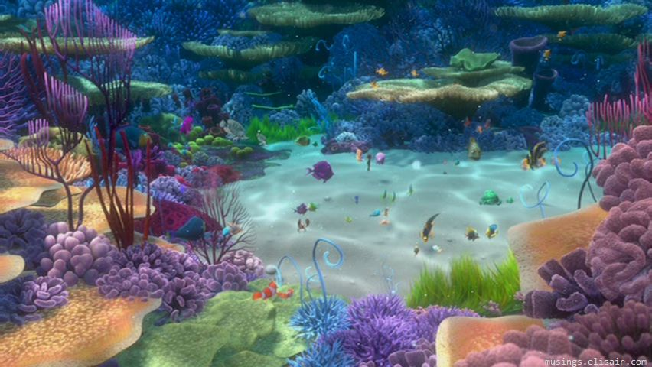
CASE STUDY
FILM: FINDING NEMO (2003) | STUDIO: PIXAR ANIMATION STUDIOS, WALT DISNEY PICTURES | IMAGE SOURCE: https://www.wallpaperup.com/
NTTW3 LIGHTNING TALK | 25 OCTOBER 2018 | EVANTHIA SAMARAS
Notes:
In his article, ‘The Lost Picture Show’, Marty Perlmutter provides the following case study about what can happen when CGI film projects are not properly archived and preserved.
“When Pixar wanted to release its 2003 film Finding Nemo for Blu-ray 3D in 2012, the studio had to rerender the film to produce the 3D effects. The studio by then was no longer using the same animation software system, and it found that certain aspects of the original could not be emulated in its new software. The movement of seagrass, for instance, had been controlled by a random number generator, but there was no way to retrieve the original seed value for that generator. So animators manually replicated the plants’ movements frame by frame, a laborious process. The fact that the studio had lost access to its own film after less than a decade is a sobering commentary on the challenges of archiving computer-generated work.”

Slide 7
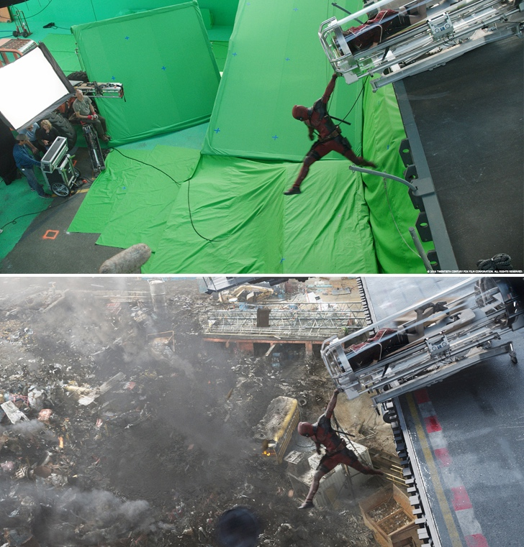
PART 2
DOCTORAL
RESEARCH
PROJECT
NTTW3 LIGHTNING TALK
EVANTHIA SAMARAS | 25 OCTOBER 2018
FILM: DEADPOOL (2016) | STUDIO: MARVEL STUDIOS, 20TH CENTURY FOX| VFX: DIGITAL DOMAIN | IMAGE
SOURCE: http://www.artofvfx.com/deadpool-alex-wang-vfx-supervisor-digital-domain/
Notes:
Ok so onto Part 2 – My PhD research

Slide 8
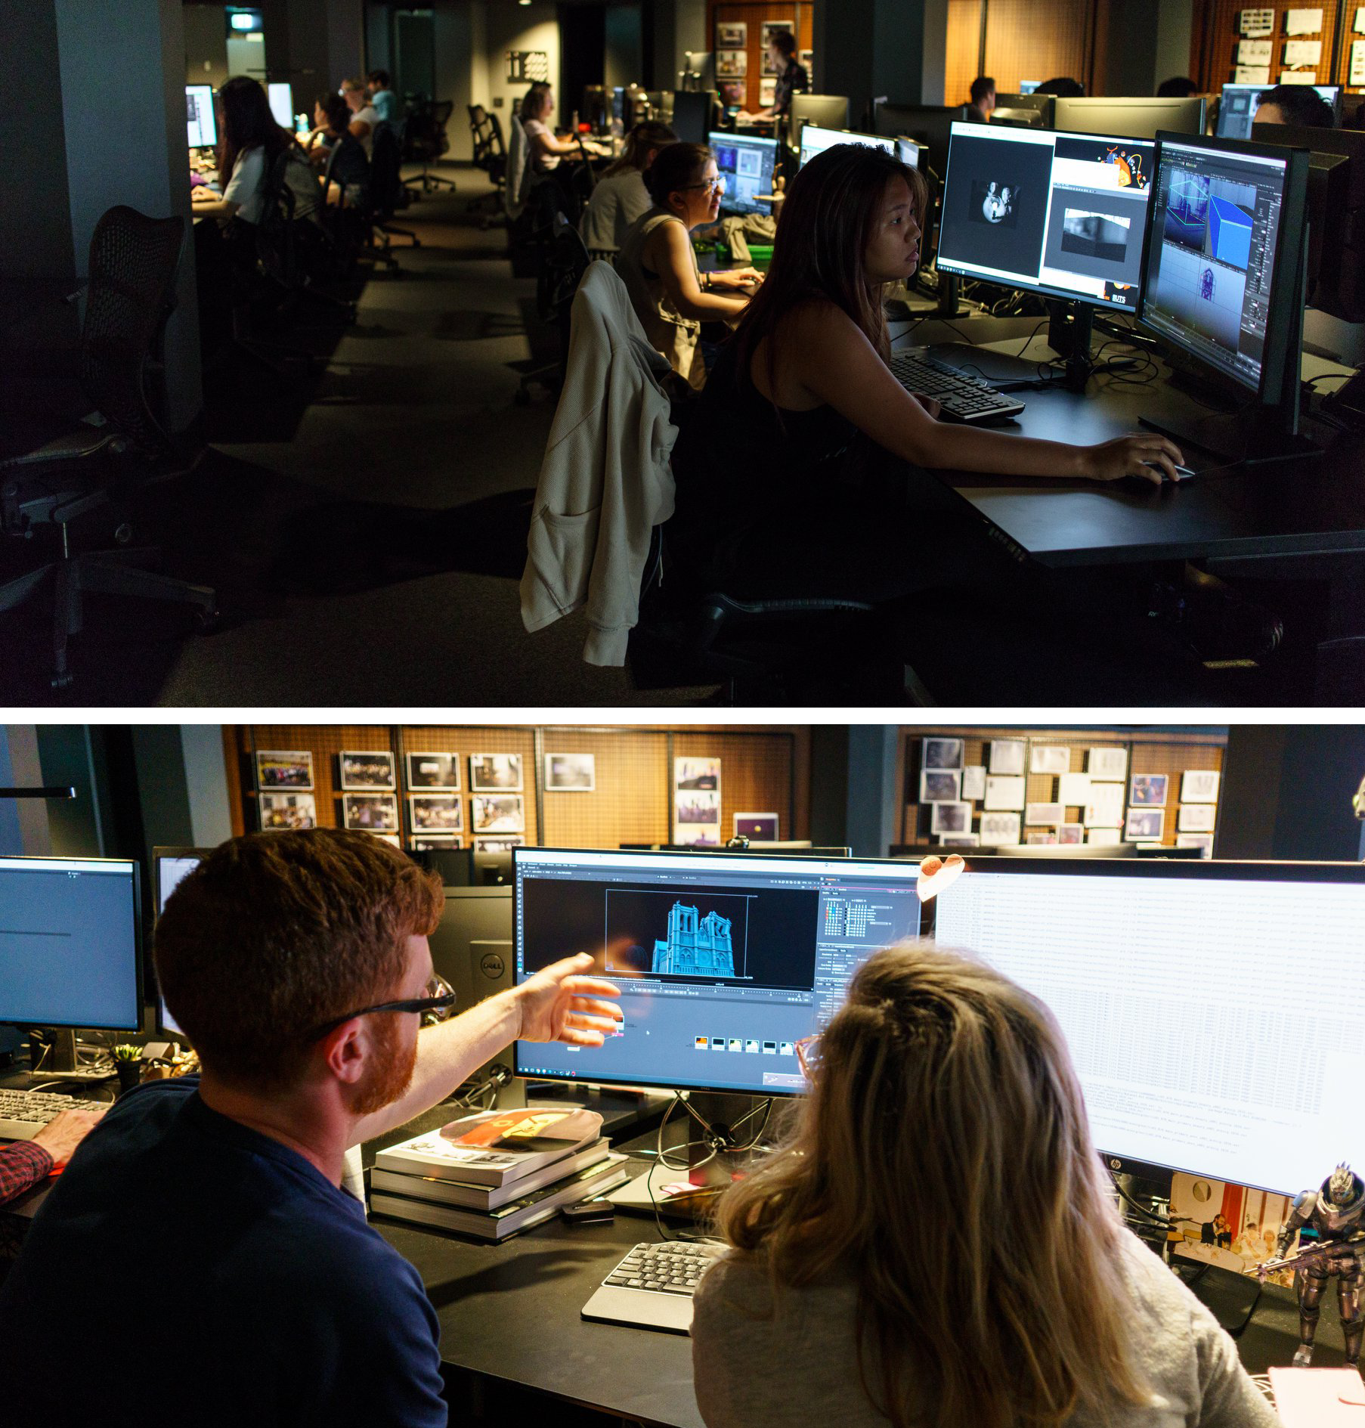
UTS ALA
UTS Animal Logic Academy (ALA) is a professionally equipped studio providing experiential learning in animation and visualisation, located at the University of Technology Sydney.
It was established to respond directly to the challenges of the VFX, animation and visualisation industries.
UTS ALA works very closely with the VFX industry to provide up-to-date knowledge and skills to the academy’s cohort.
Currently I am one of three PhD Candidates at the Academy.
CONTAT
UTS ANIMAL LOGIC ACADEMY STUDIO, UNIVERSITY OF TECHNOLOGY SYDNEY 2018 | IMAGE SOURCE: https://www.facebook.com/utsanimallogicacademy/
NTTW3 LIGHTNING TALK | 25 OCTOBER 2018 | EVANTHIA SAMARAS
Notes:
Ok so I am not studying my PhD in an information sciences school. Instead, I am doing it out of a brand new school at UTS called the UTS Animal Logic Academy. So Animal Logic is one of Australia’s biggest VFX companies. And the Academy has been set up to deliver an intensive Masters degree in animation and visualisation. The cohort learns directly from the industry to gain up-to-date knowledge and skills about VFX, animation, gaming, augmented and virtual reality. Currently there are three PhD candidates at the Academy including myself.

Slide 9
RESEARCH
THESIS
The ongoing digital preservation of significant records (including computer generated imagery) produced by the film VFX industry requires the application of archival methods—appraisal and selection, preservation, arrangement and description.
NTTW3 LIGHTNING TALK | 25 OCTOBER 2018 | EVANTHIA SAMARAS
Notes:
So my thesis proposes that the ongoing digital preservation of significant records produced by the film VFX industry requires the application of archival methods.

Slide 10
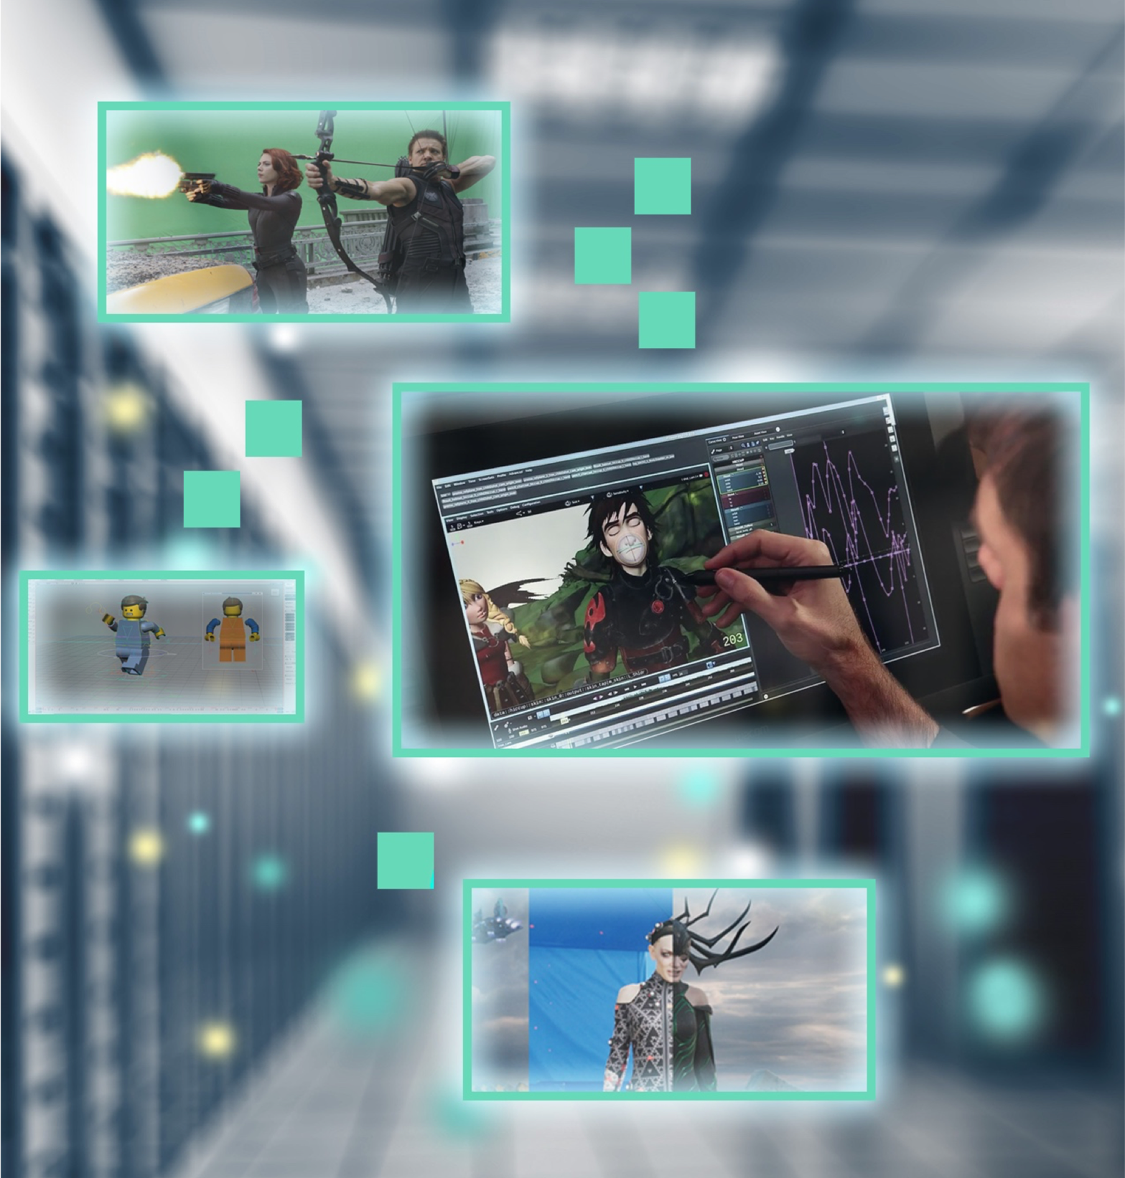
RESEARCH AIMS
01
02
Improve records management and archiving practice within the VFX industry
Ensure that significant VFX records are digitally preserved over time as culturally rich film VFX archival collections.
FILMS & IMAGE SOURCES: THE AVENGERS (2012), https://www.premiumbeat.com/ | HOW TO TRAIN YOUR DRAGON 2 (2014) , https://www.iamag.co/ | THE LEGO MOVIE (2014), https://www.premiumbeat.com/ | THOR: RAGNAROK (2017), http://www.artofvfx.com/ | FILE # 82230551, https://stock.adobe.com/
NTTW3 LIGHTNING TALK | 25 OCTOBER 2018 | EVANTHIA SAMARAS
Notes:
My research aims to:
Improve records management and archiving practice within the VFX industry
Ensure that significant VFX records are digitally preserved over time.

Slide 11
RESEARCH OBJECTIVES
01
02
03
Identify records that have historical and/or cultural value and which warrant ongoing retention and preservation as archives.
Determine which archival and metadata standards and models could be applied (or created) to arrange and describe archived VFX industry records.
Co-develop an industry resource that outlines archival concepts and recommended approaches to support archiving practice in the film VFX industry.
NTTW3 LIGHTNING TALK | 25 OCTOBER 2018 | EVANTHIA SAMARAS
Notes:
To achieve the aims, my research has these objectives:
Identify records that have ongoing value and warrant preservation as archives. To do this I will be talking with VFX practitioners and hopefully some studio archivists to understand which types of records they think should be retained long-term.
I also hope to determine which archival and metadata standards and models could be applied (or created) to arrange and describe archived VFX industry records. So this will involve researching current standards and models and looking to other comparable fields such as games preservation, software-based art and time-based media art conservation.
I also hope to co-develop an industry resource that outlines archival concepts and recommended approaches to support archiving practice. I really want my discussions with industry to guide the format and content of this resource. So at this stage, I am not sure what it will be. Basically I want the industry to direct the outcomes.
This approach draws from the Inclusive Research Design Framework developed by Sue McKemmish of Monash University in Australia and others.

Slide 12

WHY ARCHIVE VFX RECORDS?
Ensures first-hand evidence about the how, why and who of various film projects is preserved and accessible over time.
Provides valuable knowledge to support current and future VFX productions and process.
Offers historical and cultural insights into general filmmaking, visual storytelling, technical production and digital design practices.
NTTW3 LIGHTNING TALK | 25 OCTOBER 2018 | EVANTHIA SAMARAS
Notes:
So why am I doing this research? Well I have the unique experience of having worked in both the film VFX and archiving sectors. So I feel I have a pretty good idea of the benefits of archiving and preserving VFX records, which includes:
Ensuring first-hand evidence about the how, why and who of various film projects is preserved and accessible over time. So researchers won’t just rely on making-of videos, blogs and magazine articles for information.
It would provide valuable knowledge to support current and future VFX productions and process. So artists could more easily refer back to records about past productions for creative, production, design or technical information.
Plus VFX encompasses a lot of creative and technical skills. So keeping records from this industry could offer valuable insights into general filmmaking, visual storytelling, technical production and digital design practices.
OK, so that’s Part Two of my talk. I hope you have enjoyed this introduction to my research.

Slide 13
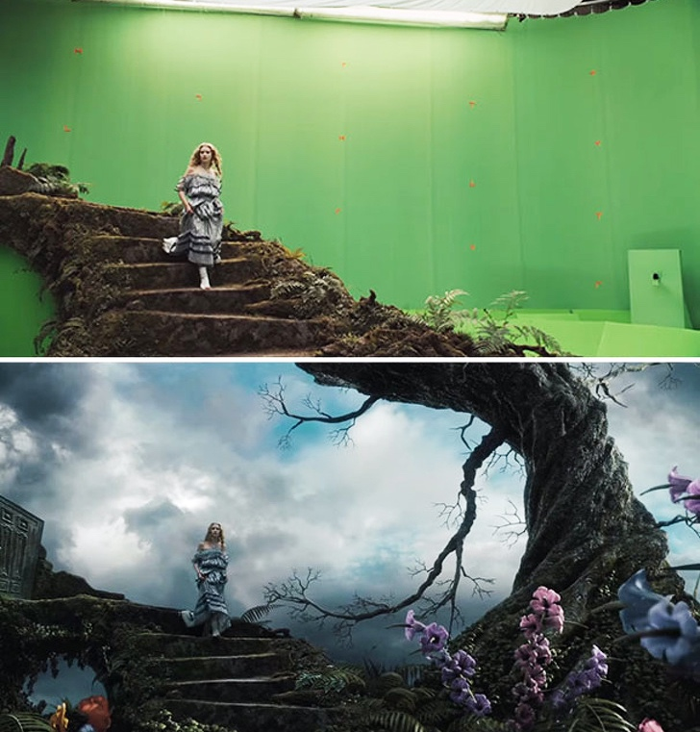
PART 3
Q&A
NTTW3 LIGHTNING TALK
EVANTHIA SAMARAS | 25 OCTOBER 2018
FILM: ALICE IN WONDERLAND (2010) | STUDIO: WALT DISNEY PICTURES | VFX: SONY PICTURES IMAGEWORKS IMAGE SOURCE: https://brightside.me/
Notes:
Now, we are up to the final section of the talk: question time.
Does anybody have any questions?

Slide 14
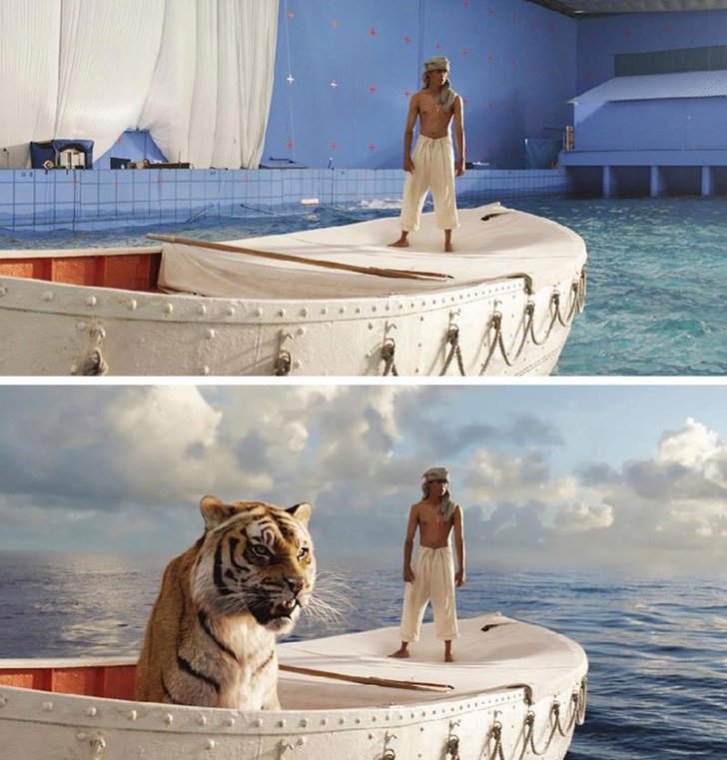
THANK
YOU
Email: Evanthia.Samaras@student.uts.edu.au
Twitter: @CyberKittyFace
CONTACT
More on UTS ALA: https://animallogicacademy.uts.edu.au/
FILM: LIFE OF PI (2012) | STUDIO: FOX 2000 PICTURES | VFX: RHYTHM & HUES | IMAGE SOURCE: https://fxrant.blogspot.com
NTTW3 LIGHTNING TALK | 25 OCTOBER 2018 | EVANTHIA SAMARAS
Notes:
Thank you for listening. Please feel free to get in touch or come and say hello during the break.

